Slide 1

Renewable Energy Directive, RED III, bioenergy rules – EP ENVI position
Impact assessment for Sweden

Slide 2
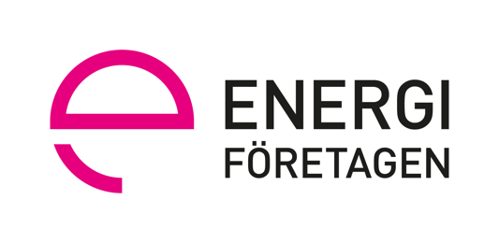




Joint impact assessment on RED III proposal in June 2022

Slide 3
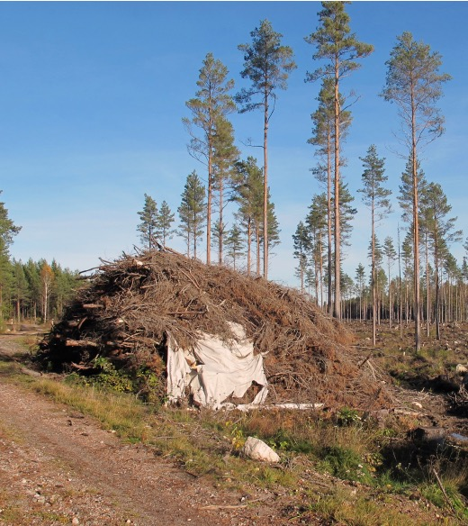
ENVI position RED III bioenergy rules
Slash (tops and branches) from harvesting sites is collected and dried in piles over summer at roadside. When fuel is needed, the slash will be chipped by mobile chippers and transported to nearby heat plants.
The slash can not be used by industry but has good energy value.
If the slash is not collected, it will decompose and release most CO2 within a decade.
Collecting the slash makes replanting of the harvesting sites easier and the growth of new forest can start earlier.
The total use of slash for heating is around 10 TWh in Sweden today, but there is large potential to increase the collection of slash.
According to a research review from the Swedish Energy Agency both the current use and an increased use from today’s levels do not influence biodiversity in a negative way.
Primary woody biomass is not counted towards renewable energy targets
No support to primary woody biomass
Detailed legislation on cascading use to be defined
Extended and undefined “no-go areas”
National legislation to ”Prevent clear-cuts”, i.e. banning most modern forestry
Impact assessment
This assessment describes some of the impacts on the energy system, but not the overall impacts on forest-based bioeconomy
The assessment is delimited to primary woody biomass and/or banning energy use of residues from modern forestry

Slide 4
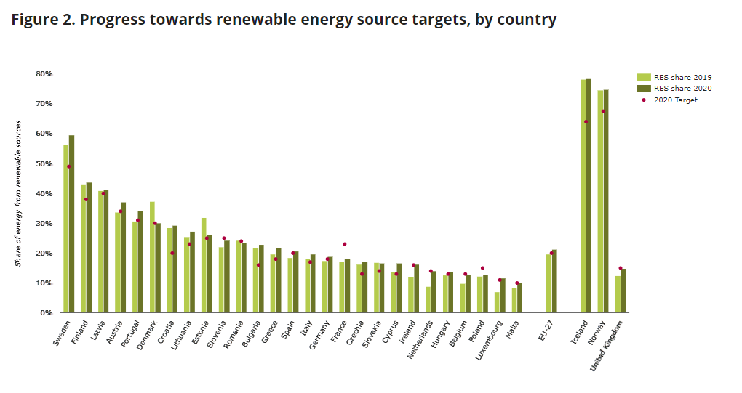
The impacts are mainly on cost and investor trust
Classifying primary woody biomass as non-renewable and not eligable for support would eventually lead to it being treated as fossil fuels
This means significant cost for GHG-emissions in emission trading system and/or taxation
It would also mean that no support would be given to much needed climate innovations like transport fuels to all sectors, more flexible energy systems, fossil-free industry processes or carbon dioxide removals
Current and future investments based on primary woody biomass would be at risk of being stranded assets or cancelled
The general investor trust in climate mitigation policy would be damaged

Slide 5
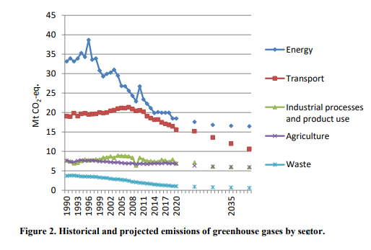
Significant impact on the Swedish energy system and efforts in renewable energy and climate mitigation
Climate targets and renewable energy potentials in energy, transport, industry and carbon dioxide removal will not be fulfilled
The energy and transport systems will be less flexible, reliable, renewable and affordable
About 20 TWh of renewable energy is removed, which is about 5% of the final energy use in Sweden or 10% of the renewable energy use
About the same volume of future potential for renewable energy is also removed

Slide 6
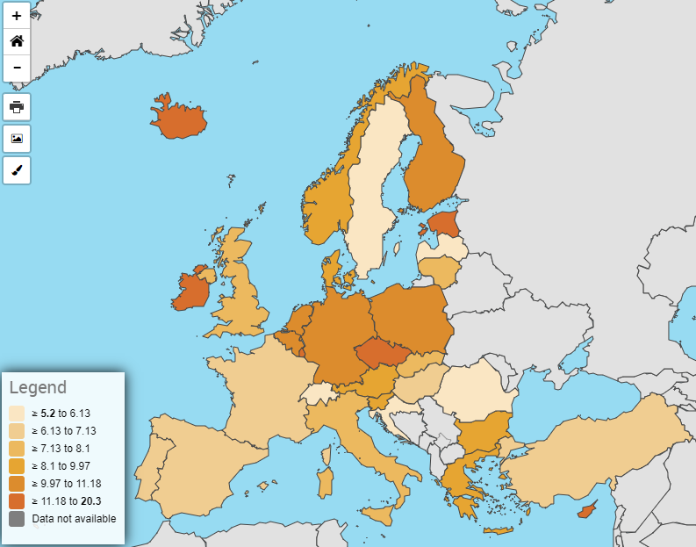
Decades of climate mitigation is undermined
Sweden has the lowest GHG-emissions and the most ambitious climate targets
  Net-zero in 2045
  Minus 70 per cent emissions from domestic transport in 2030
Forest-based bioeconomy including waste and residues for bioenergy is a core climate mitigation solution in Sweden
The ENVI position undermines the forest-based bioeconomy by classifying modern forestry as unsustainable
Greenhouse gas emissions per capita, Eurostat, data for 2019

Slide 7
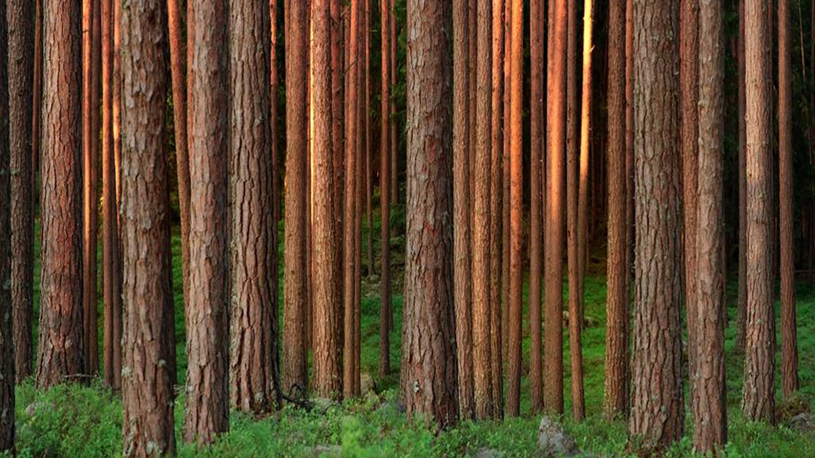
Risk of reduced climate mitigation potential in Sweden when banning primary woody biomass
The climate mitigation potential connected to primary woody biomass adds up to a large part of the GHG emissions in Sweden.
7 million tonnes of already achieved emission reductions in heat and power
7-8 million tonnes in road transportation
Several million tonnes in maritime transportation and aviation
Several million tonnes in industrial processes and energy sector
3-10 million tonnes in BECCS and BECCU

Slide 8

Direct impacts on the Swedish Energy system

Slide 9
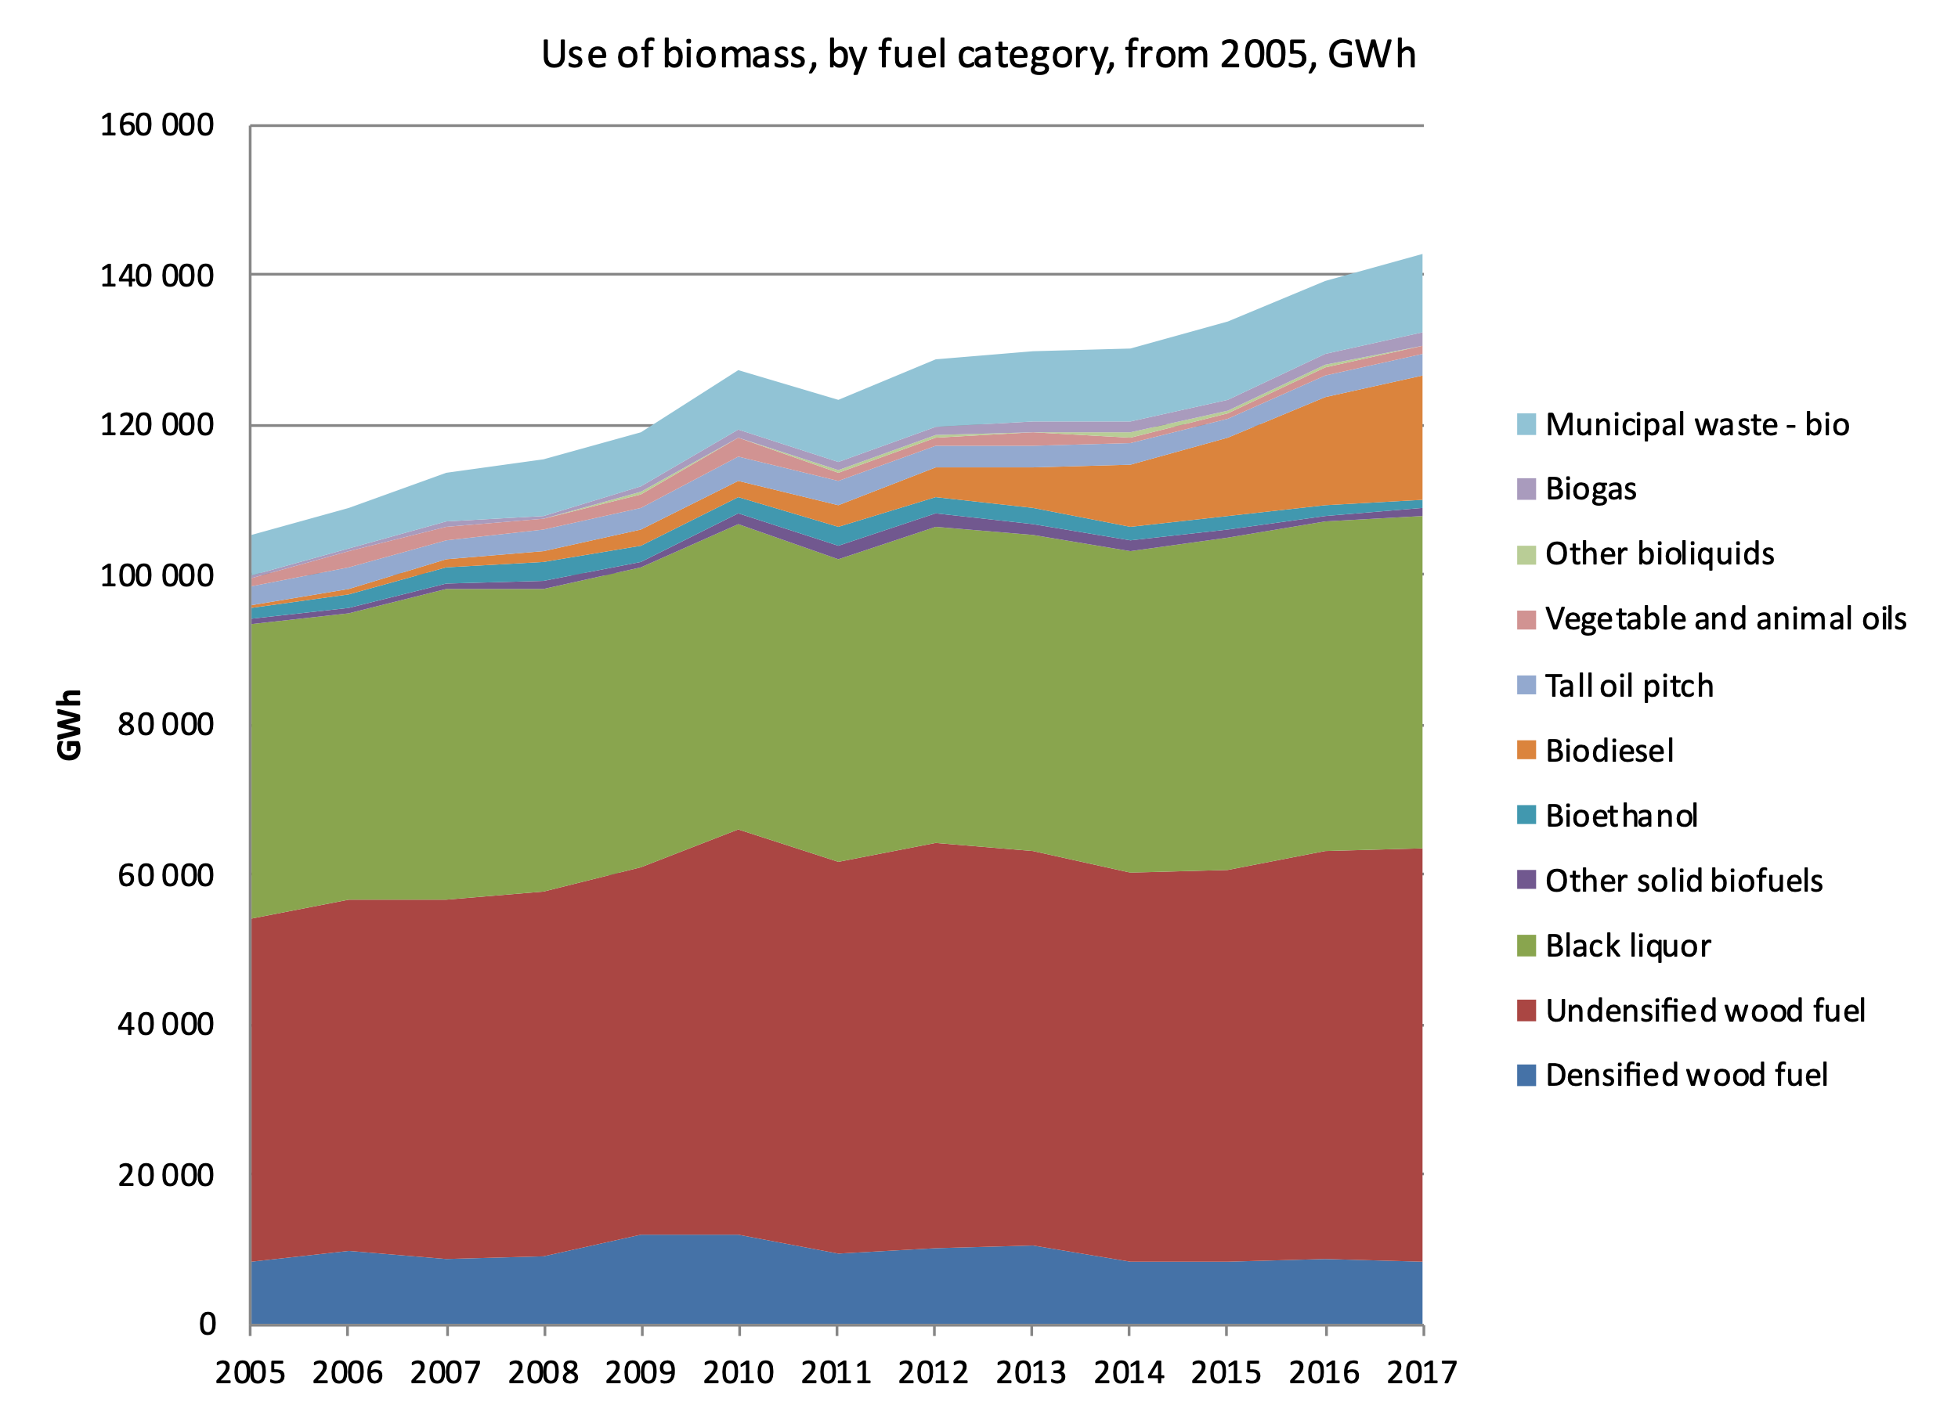
About 20 TWh of Swedish energy supply is primary woody biomass
The primary woody biomass used in Sweden is tops and branches, thinnings and damaged wood
There is no other commercial use for the residues besides energy use
20 TWh of coal would give release about 7 million tonnes of CO2
About half of undensified wood fuel is primary woody biomass

Slide 10
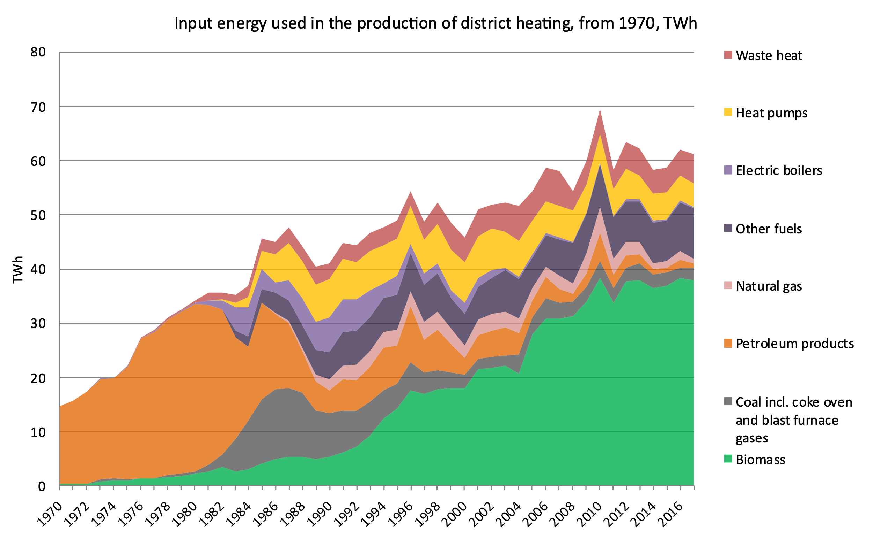
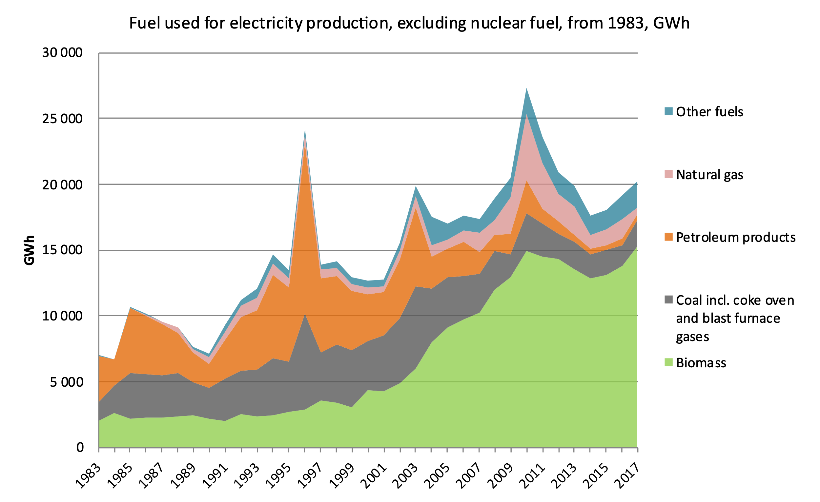
Primary woody biomass is an important fuel in heat and power production
Without primary woody biomass, the energy system will be less flexible, robust and affordable
Higher cost for renewable fuels and stranded assets in heat and power production
Need of new investments that will cause more stress on environment, energy system, household's economy and industrial customers
Swedish Energy Agency

Slide 11
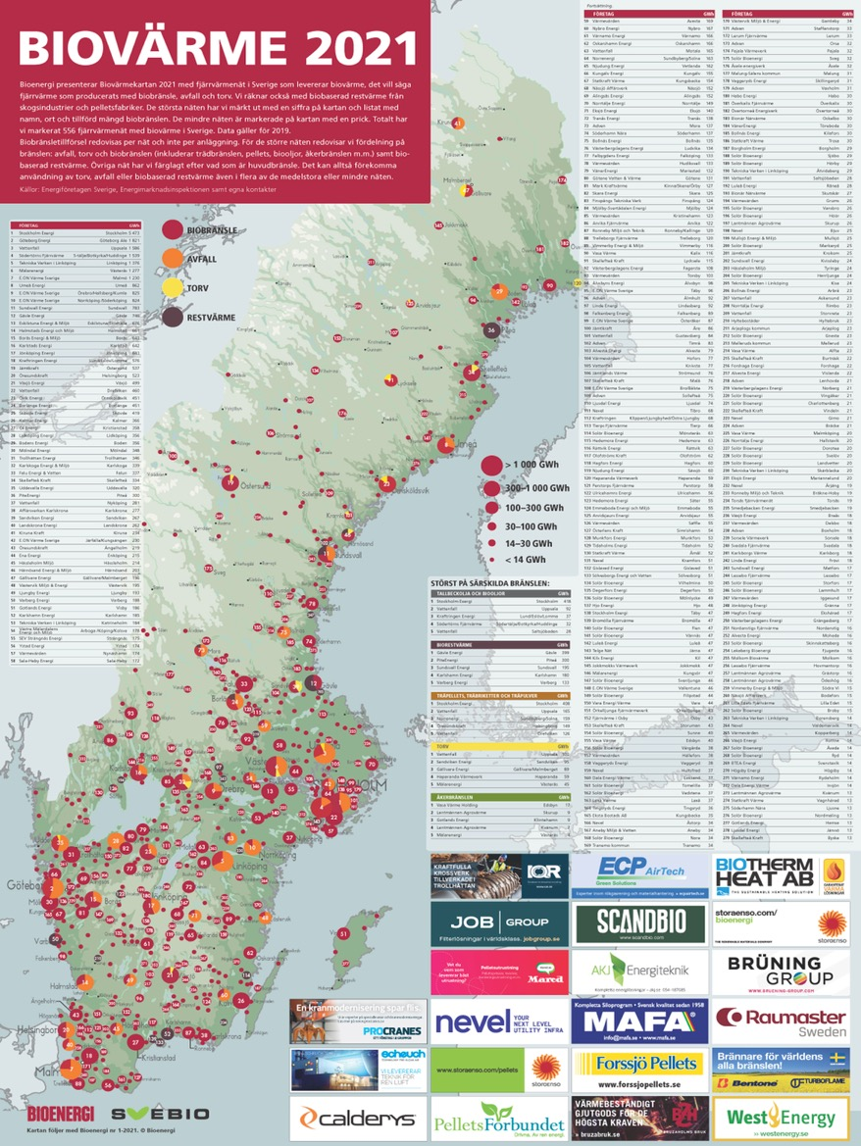
Security of supply with local use of residues
Bioheat in Sweden 2021
RePowerEU underlines the importance of domestic renewable energy sources to replace fossil imports
Heat
Sweden has 550 heat plants using biomass fuels, mostly locally sourced
Almost no use of fossil fuels for heating, and very low dependence on imports
Local production which decrease stress on electricity network
Power
90 units for combined heat and power in district heating and forest industry offer dispatchable electricity production much needed in a power system with increased share of variable power like wind and solar

Slide 12
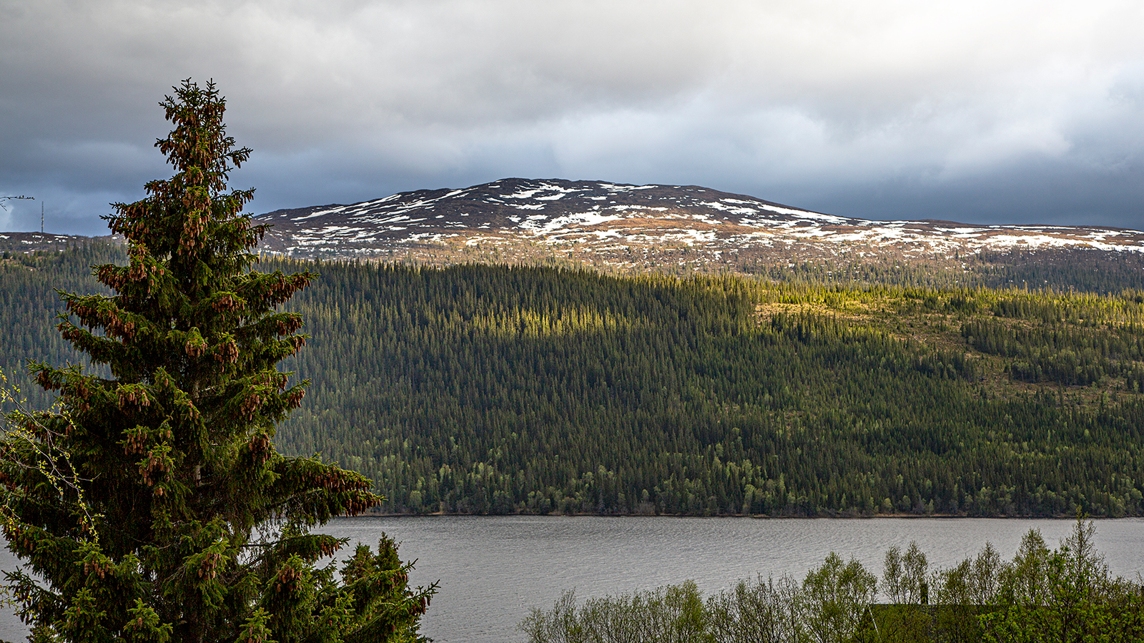
Impacts on Swedish climate mitigation potential and policy

Slide 13
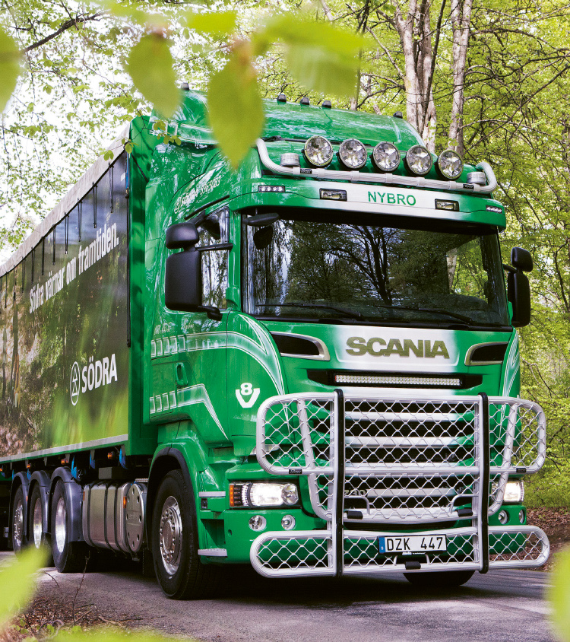
Potential to increase the use of primary woody biomass in Sweden: 21-25 TWh per year
Fossil Free Sweden* has compiled industry/sector road maps for transitions to fossil-free options
It is estimated that there is a potential for increased use of primary woody biomass with up to 21-25 TWh per annum around 2030, with full consideration of sustainability aspects
It is estimated that even with significant efficiency measures there is an increased demand for sustainable biomass
A large part of the increased use would likely be directly or indirectly connected to domestic production of transport fuel
The current use of bioenergy in Sweden is about 158 TWh per year, with about 26 TWh import of transport biofuel
*Fossil Free Sweden was started at the initiative of the Swedish Government in 2015 ahead of the major UN climate conference in Paris and brings together actors in the form of companies, municipalities, regions and organisations that give their backing to the declaration that Sweden will be one of the first fossil free nations in the world.

Slide 14
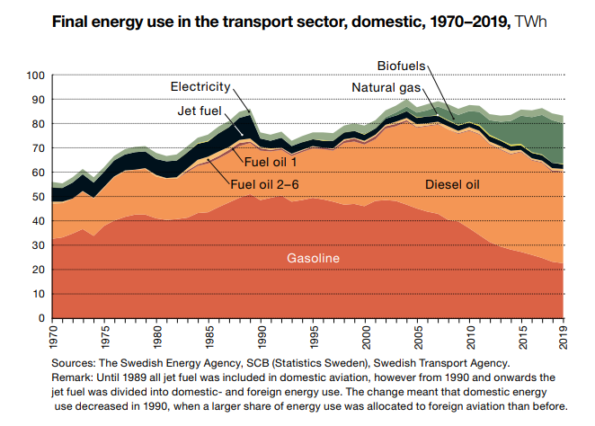
The Swedish target of reducing emissions from domestic transportation by 70% at 2030 will be impossible to reach
The target could mainly be achieved by biofuels in the greenhouse gas reduction quota
The ambition is to mainly use domestic biofuels directly or indirectly based on primary woody biomass
Without primary woody biomass there is no possibility to fulfil the target and up to 7-8 million tonnes of CO2 will not be mitigated*
That is about 17% of the territorial emissions in Sweden 2020**
Sweden will not reach 50% GHG reduction in the ESR until 2030
*Estimated climate effect of the GHG reduction quota, Kontrollstation 2019, Proposition 2020/21:180
**https://www.naturvardsverket.se/data-och-statistik/klimat/vaxthusgaser-territoriella-utslapp-och-upptag

Slide 15
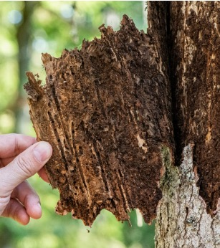
The large scale electrification of industry and transport will be hindered
The electricity demand in Sweden is projected to be doubled or tripled over a few decades due to the climate transition in industry and other sectors
Big potential to increase biopower production, if more sustainable biomass can be supplied
Biomass can be used for flexible power system and balancing grid in a system with high share of variable power production
There is no room for removing current or future electricity production, especially not reliable and flexible production

Slide 16
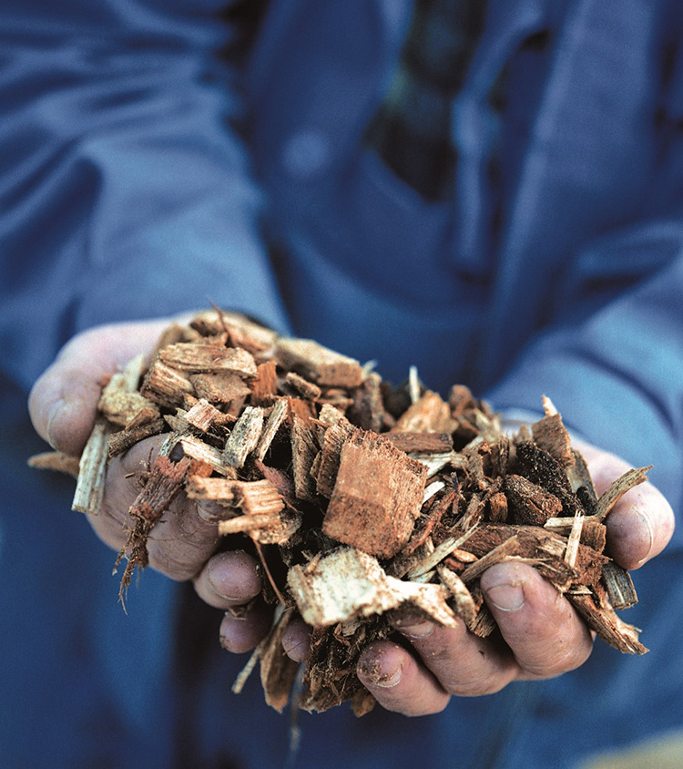
The development of BECCS and CCU will be hampered
The impact of classifying a significant part of the used biofuel fuel as non renewable would be devestating for BECCS development
In the Swedish public inquiry ”The road to a climate positive future” it is stated that there is a possible need and potential for 3 to 10 million tonnes of BECCS in 2045
The technical potential for BECCS and CCU is significantly larger
The Swedish government and many businesses are already making fast advances towards real investments in BECCS
A first large-scale might be in operation in 2025, and an ambition in the energy sector that all large facilities are connected to BECCS in 2045

Slide 17
Extra material

Slide 18
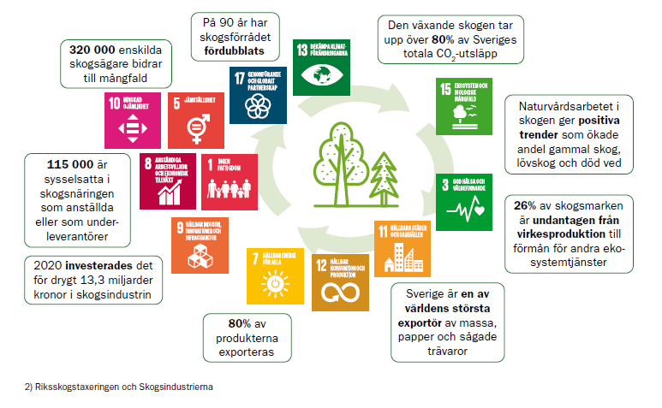
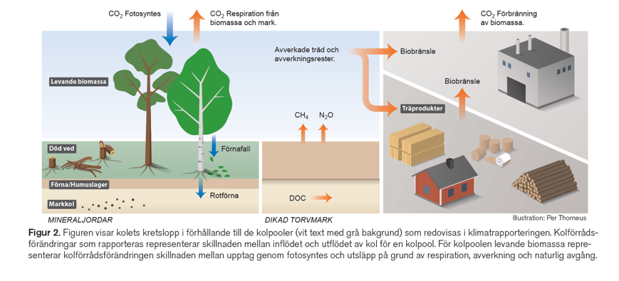
70 % of Sweden’s land area is forests
Figurer från LRF Skogsägarna och SLUs Fakta skog 2022:7

Slide 19
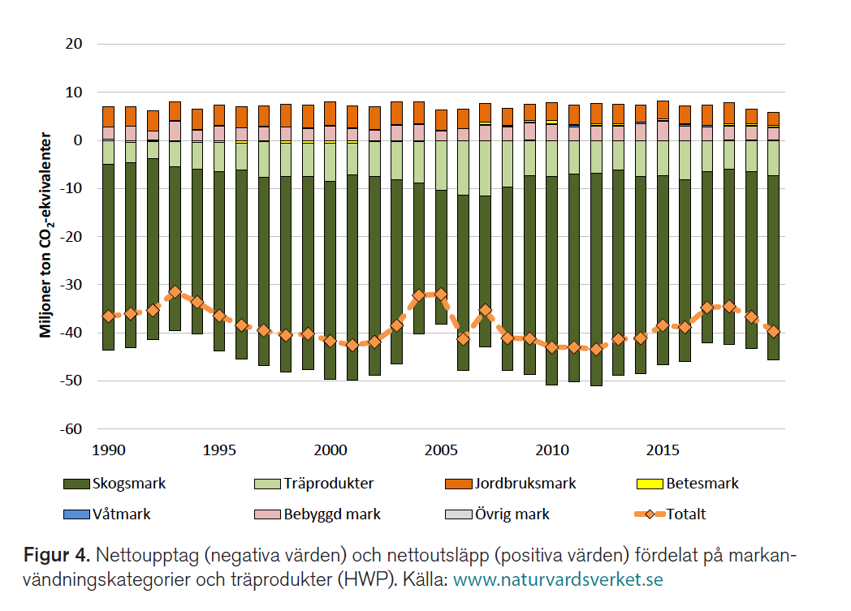
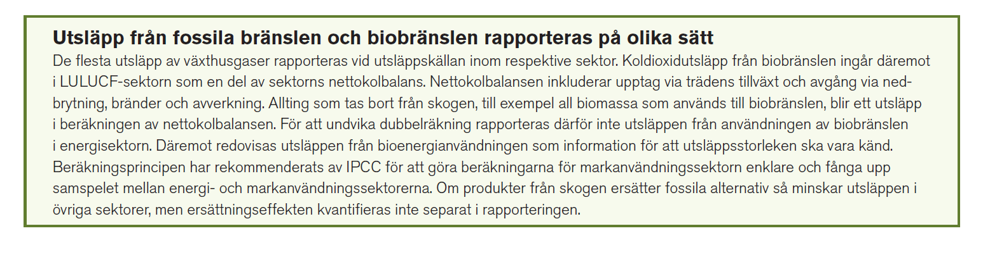
LULUCF
"The LULUCF-sector contributed to the total greenhouse gas budget with an annual net removal of greenhouse gases in Sweden during the period 1990—2021. During the period the annual net removals have varied between 30 and 45 million tonnes of carbon dioxide equivalents."
Figurer från SLUs Fakta skog 2022:7

