Slide 1
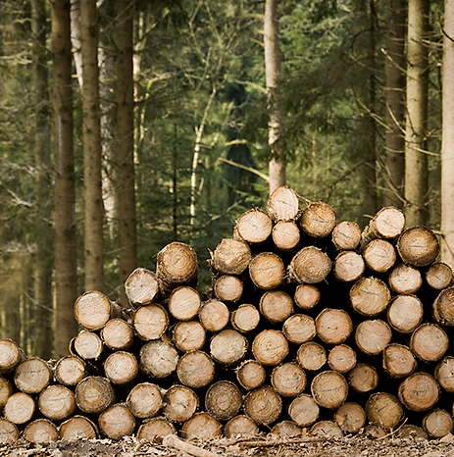
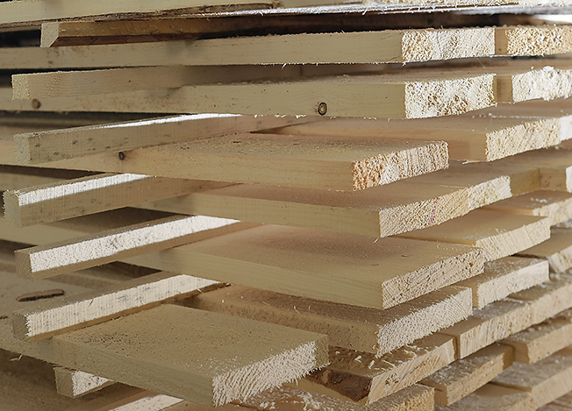
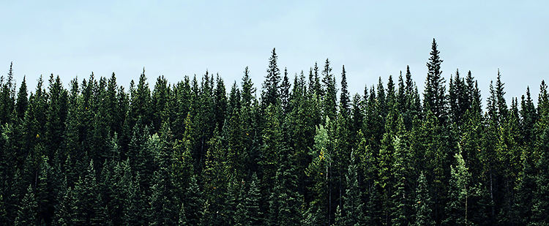
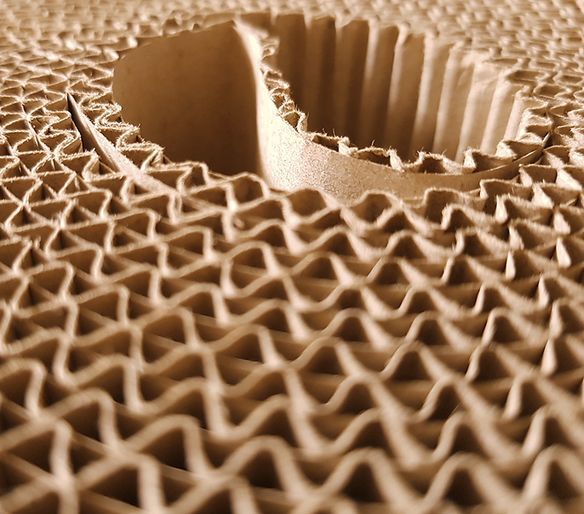
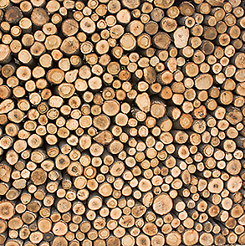
Everything is taken care of
Koll på skogen
forest and forestry
Import of sawn timber
1 million m³
Export of pulpwood
0.8 million m³
34.6
million
m³ sawn timber
Sawmill
35.6 million m³
Appr. 10 million m³ wood chips
From the forest*
Pulp and paper industry
47.4 million m³
30.7
million
m³ pulpwood
Export of sawn timber
0.5 million m³
*In addition to the industrial roundwood from the forest, 6.3 million m3 of roundwood is also taken out for other purposes, such as firewood and wood for household use.
Import wood of pulpwood and chips
6.7 million m³
m³ refers to cubic meter solid under bark, i.e. wood volume without bark and top.
Notes:
Just over 85 percent of the wood used by the Swedish forest industry comes from domestic sources. Roughly half of this raw material is used as sawlogs, while the other half goes to pulp and paper mills. Even by-products, such as wood chips from sawmills, which are left over from the sawing process and used in pulp and paper production, carry significant economic value.

Slide 2
The volume of trees in Swedish forests has been steadily increasing since the 1920s.
The diagram shows how Swedish forests are slowly becoming more diverse. While conifers such as pine and spruce are the most prevalent tree species, the proportion of birch and other broad-leaf trees is increasing.
Growing stock volume is a measurement of the total amount of usable wood in a forest.
Five-year average, stated as middle year; e.g., 2018-2022 = 2020
Source: Swedish University of Agricultural Science

Slide 3
Forest growth exceeds harvesting
The total volume of trees in Swedish forests is now twice as large as it was 100 years ago. This is due to a long-term focus on replanting and on management methods that promote forest growth. Trees are denser, grow faster, and the plant material is of better quality.
The diagram below shows how much the forest grows each year. ’Total withdrawal’ shows the amount harvested through forestry operations, along with trees that have fallen due to natural competition or to snow or storm damage, etc. The effects of the two major storms of 2005 and 2007 can be clearly seen in the diagram.
Five-year average, stated as middle year; e.g., 2018-2022 = 2020
Source: Swedish University of Agricultural Sciences

Slide 4
Swedish forests becoming more diverse
One way to measure biodiversity is to examine the conditions that allow various species to thrive. Dead trees – often referred to as deadwood – are essential for many species, which is why they are both created and left to lie in the forest after harvesting. The number of old trees and old forests has increased, and forests are more diverse, which promotes biodiversity.
The diagrams show how several trajectories change direction in the 1990s with the introduction of a new forest policy, with equal weight given to production and the environment. Sweden also introduced a new Forestry Act in 1994.
Vertical dotted line marks when the Forestry Act came into force.

Slide 5
67% of Swedish forests are certified
Certified productive forest area by certification type
There are two established, international certifications in Sweden for responsible forestry: PEFC and FCS.
In 2024, close to 14.7 million hectares of productive forest land was certified – 67 per cent of all productive forest land that is not formally protected.
Source: Swedish National Forest Inventory 2024

Slide 6
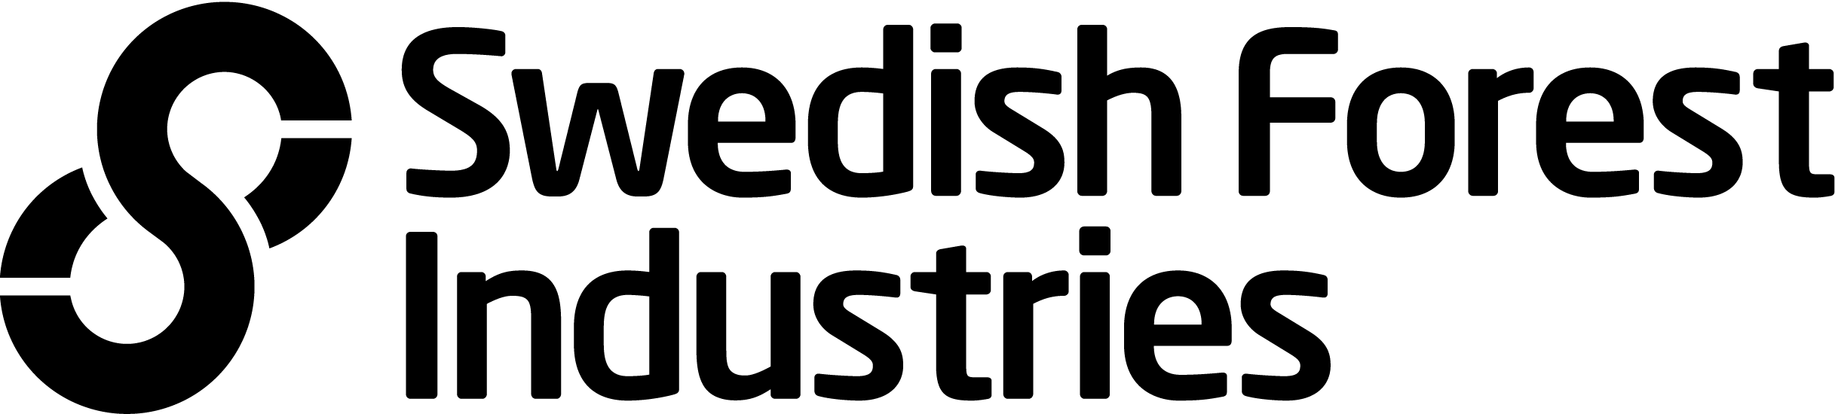
Who owns the forest?
Approximately one quarter of Swedish forests are owned by private forest companies.
One quarter are owned by the state, municipalities and the Church of Sweden.
Almost half of Swedish forests are owned by 308,000 private individuals – which means that 3 per cent of Swedes are forest owners. In Sweden, forests are often passed down from generation to generation. (2024)

Slide 7
Forest coverage in Sweden
Nearly 70 per cent of Sweden’s land area is forested. Three per cent is comprised of built-up areas, and the remainder of marshland, agricultural land and other land.
Source: Statistics Sweden (SCB)

Slide 8
Forest coverage in Europe
Forests cover 39 per cent of the EU’s land area. In contrast to many areas of the world where deforestation remains a serious problem, forest cover in the EU is increasing.
According to Eurostat statistics, around eight million hectares of forest were added between 2000 and 2022 – an increase of 5.5 per cent.
Source: Statistics Sweden (SCB)

Slide 9
European forests
Forest areas in the EU
By country, 1,000 hectares
The five EU-states with the largest forest areas are Sweden, Finland, Spain, France and Germany.
The many different types of forests in the EU reflect the Union’s geographical and climatic diversity (boreal forests, alpine coniferous forests, etc.).
Source: Eurostat

